Slide 1




#EVCapital
European Volunteering
Capital 2024 Competition
Strengthen, inspire and celebrate
volunteering in Europe

Slide 2
WHAT is #EVCapital
# Recognise and reward municipalities that support volunteers and volunteering in their communities. # Serve as a source of inspiration and motivation for all municipalities across Europe to make even greater efforts to promote and celebrate volunteering.

Slide 3










The story so far...
# EVCapital 2014: Barcelona
# EVCapital 2015: Lisbon
# EVCapital 2016: London
# EVCapital 2017: Sligo
# EVCapital 2018: Aarhus
# EVCapital 2019: Kosice
# EVCapital 2020: Padova
# EVCapital 2021: Berlin
# EVCapital 2022: Gdansk
# EVCapital 2023: Trondheim
Will your municipality be the European Volunteering Capital 2024?

Slide 4
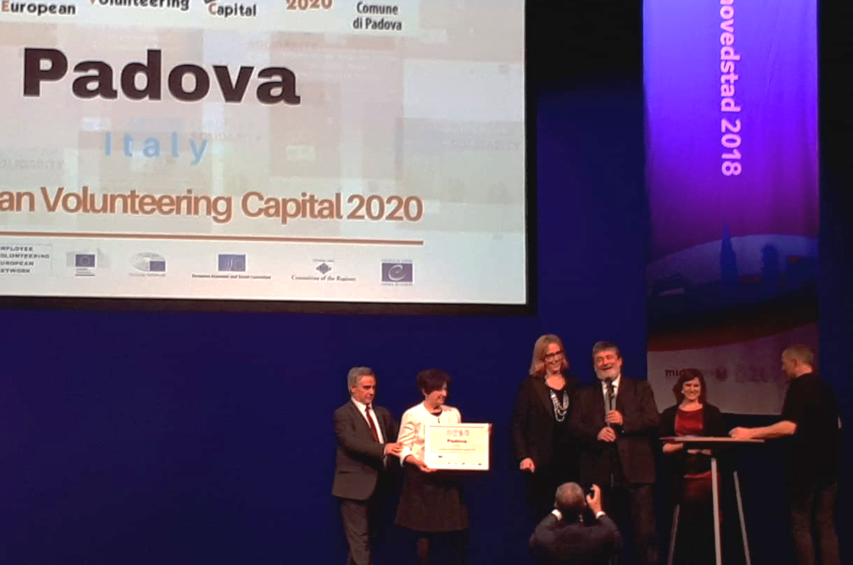

#EVCapital 2020
# Padova (Italy)

Slide 5

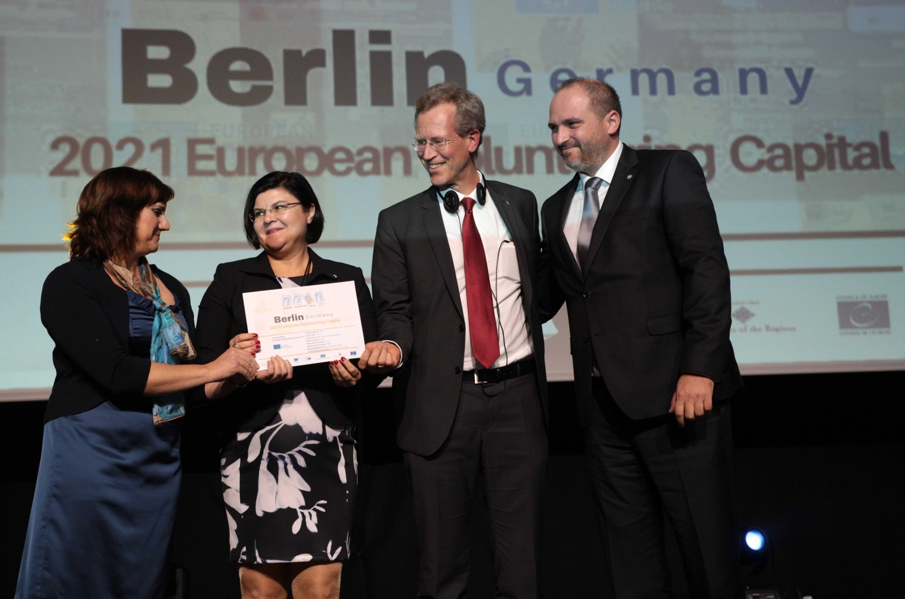
#EVCapital 2021
# Berlin (Germany)

Slide 6


#EVCapital 2022
# Gdansk (Poland)

Slide 7

#EVCapital 2023
# Trondheim (Norway)

Slide 8
New call is open!
Check the call!
&
Apply by: 3 June 2021

